Slide 1
Song Lyrics Over Time
Devi Somalinga Bhuvanesh
Gurrup Kaur Gurbir Singh Soi
Vy Hoang Mai Duong
Northeastern University, Seattle
Source: lyrics_with_sentiment. (2021, May 9). Kaggle. https://www.kaggle.com/datasets/keeschristiaanse/lyrics-with-sentiment?select=lyrics_sentiments.csv
Notes:
Devi: 1-3+11
Gurrup: 4-5
Vy: 6-10

Slide 2
Summary
Data Preparation
01
Combine and delete variables
Duplicated, Missing values, & New Variable Column
Exploratory Analysis
02
Overview of the songs characters
Changes over Time
03
Favorite words, Song length, Song sentiment and Genre over the Decades

Slide 3
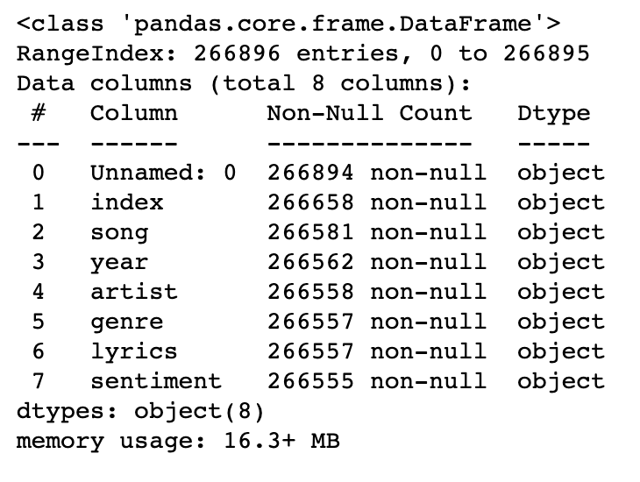
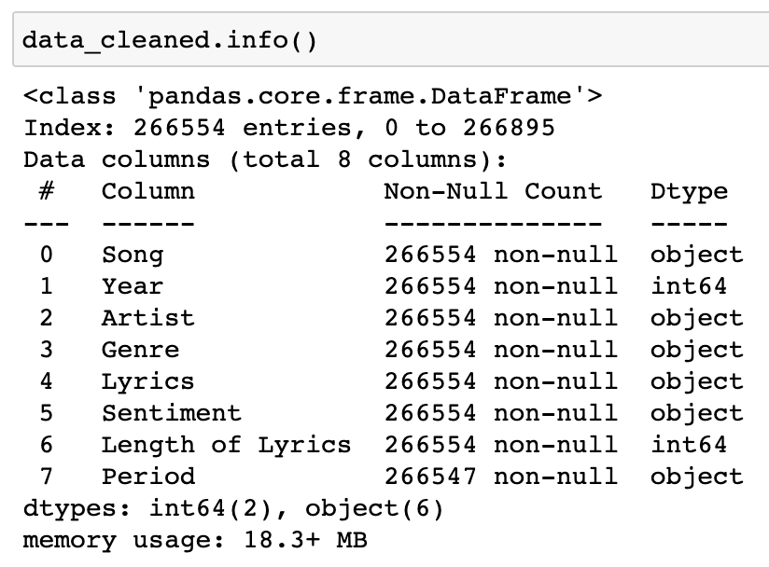
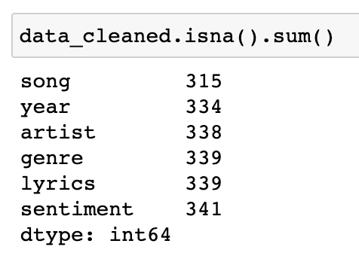
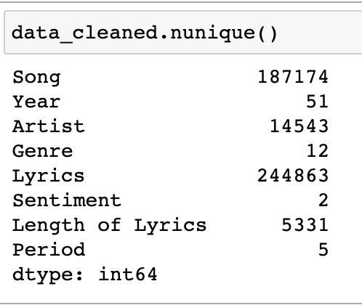
Data Preparation
2 columns were removed – Unnamed and Index
Two new columns were created:
"Length of lyrics" column - Shows the word count of lyrics of the songs.
"Period" column – Compiled year-wise data of songs released in a period.
Missing and duplicate values in all variables were identified and removed
Formatted the column names
Missing Values
Unique Values

Slide 4
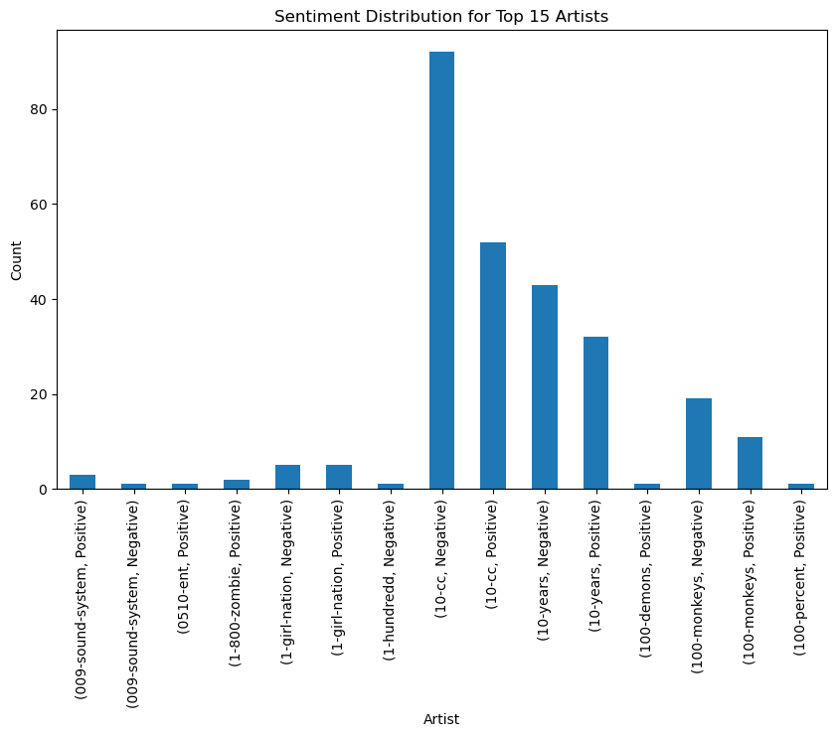
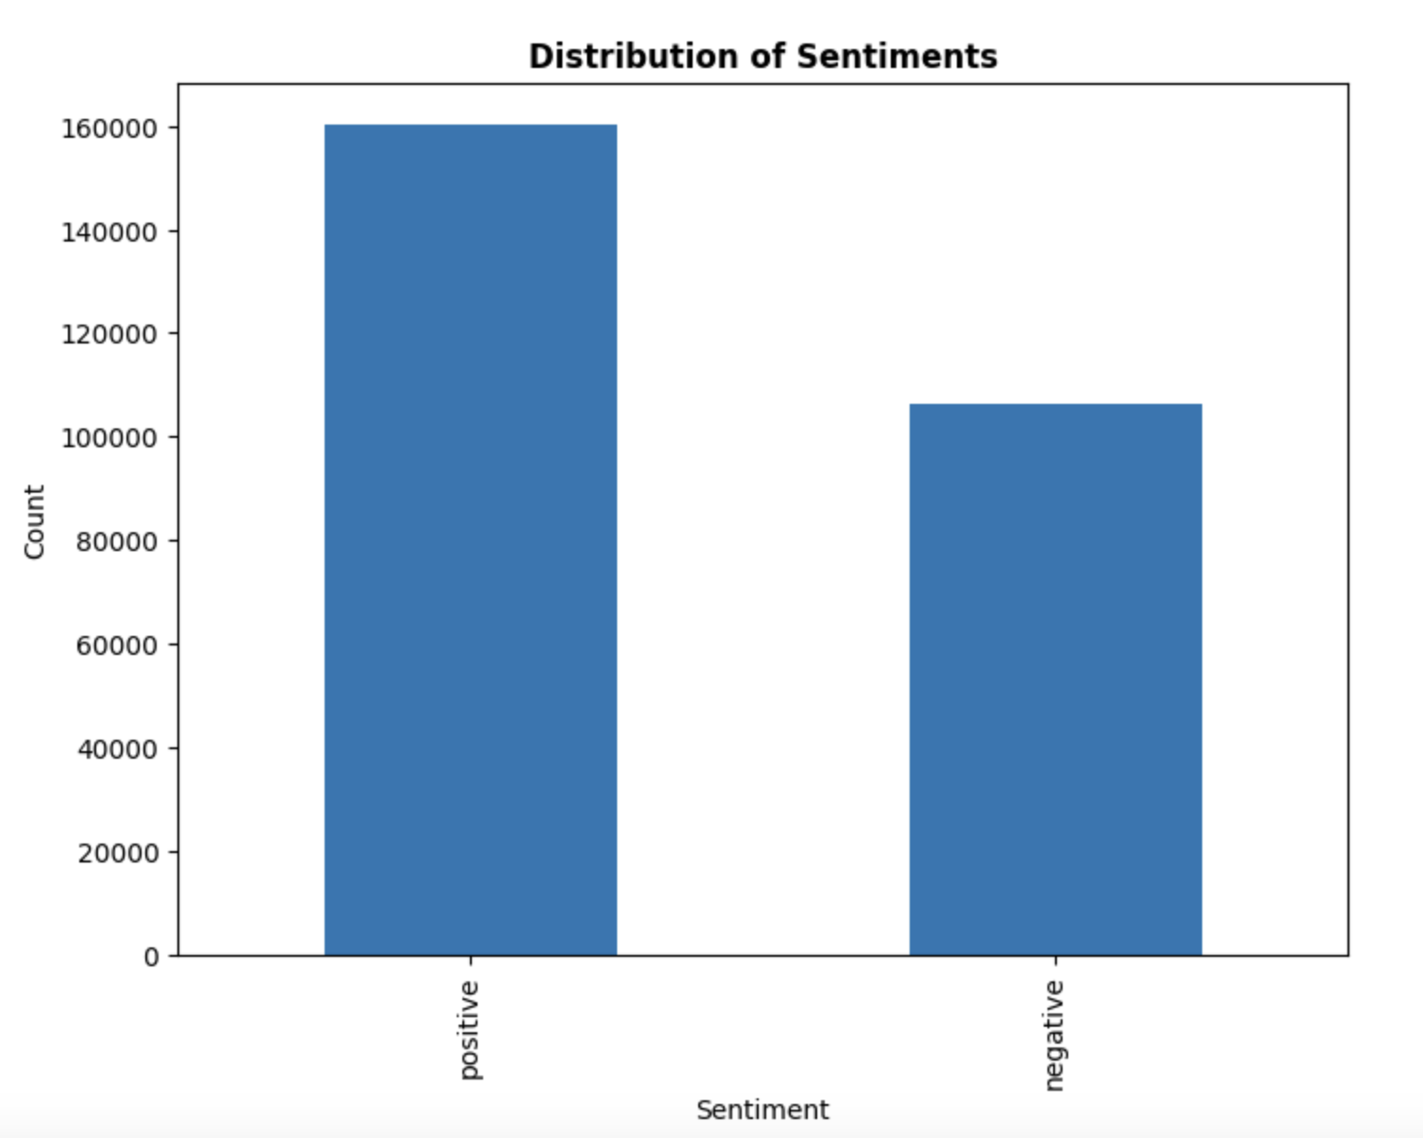
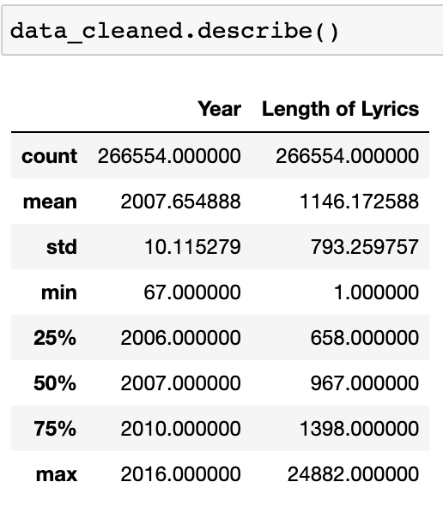
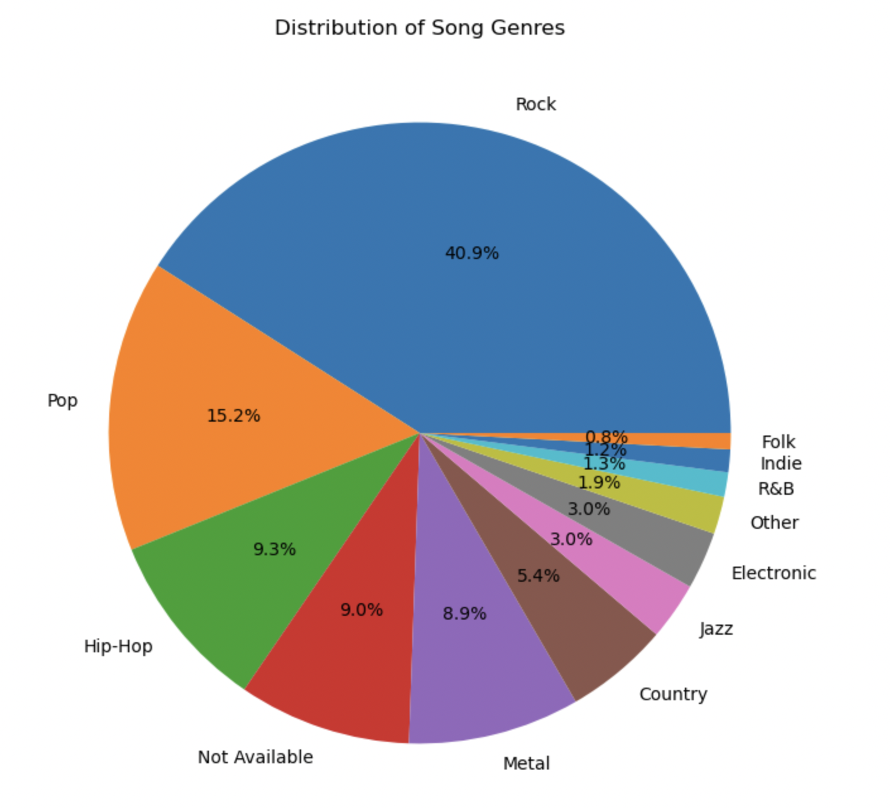
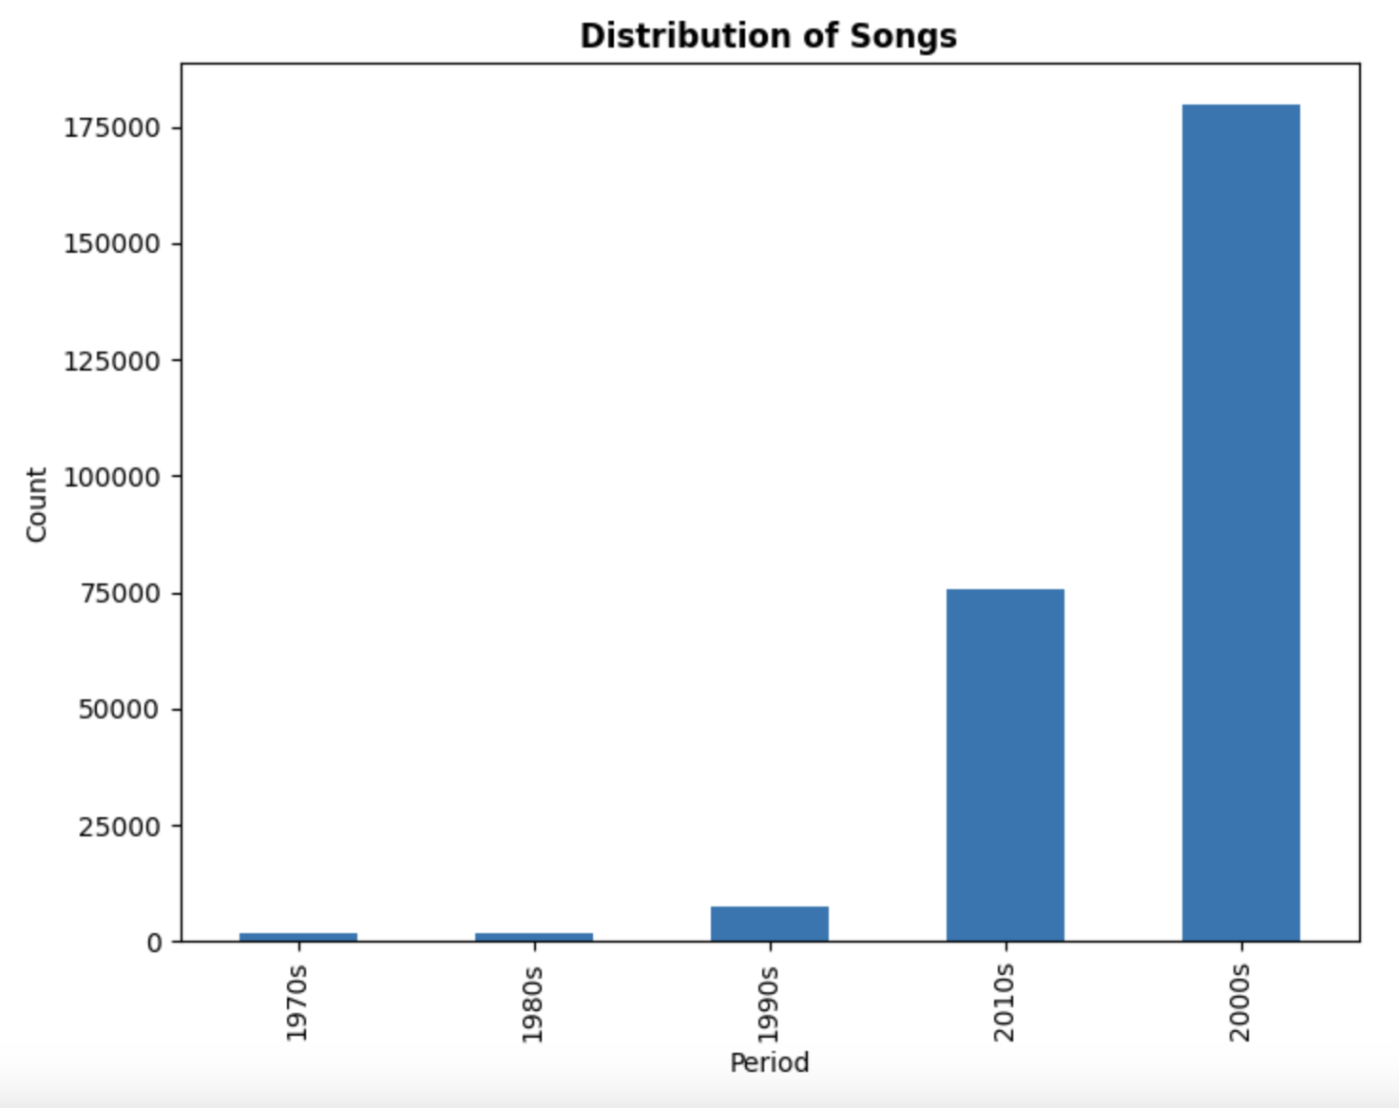
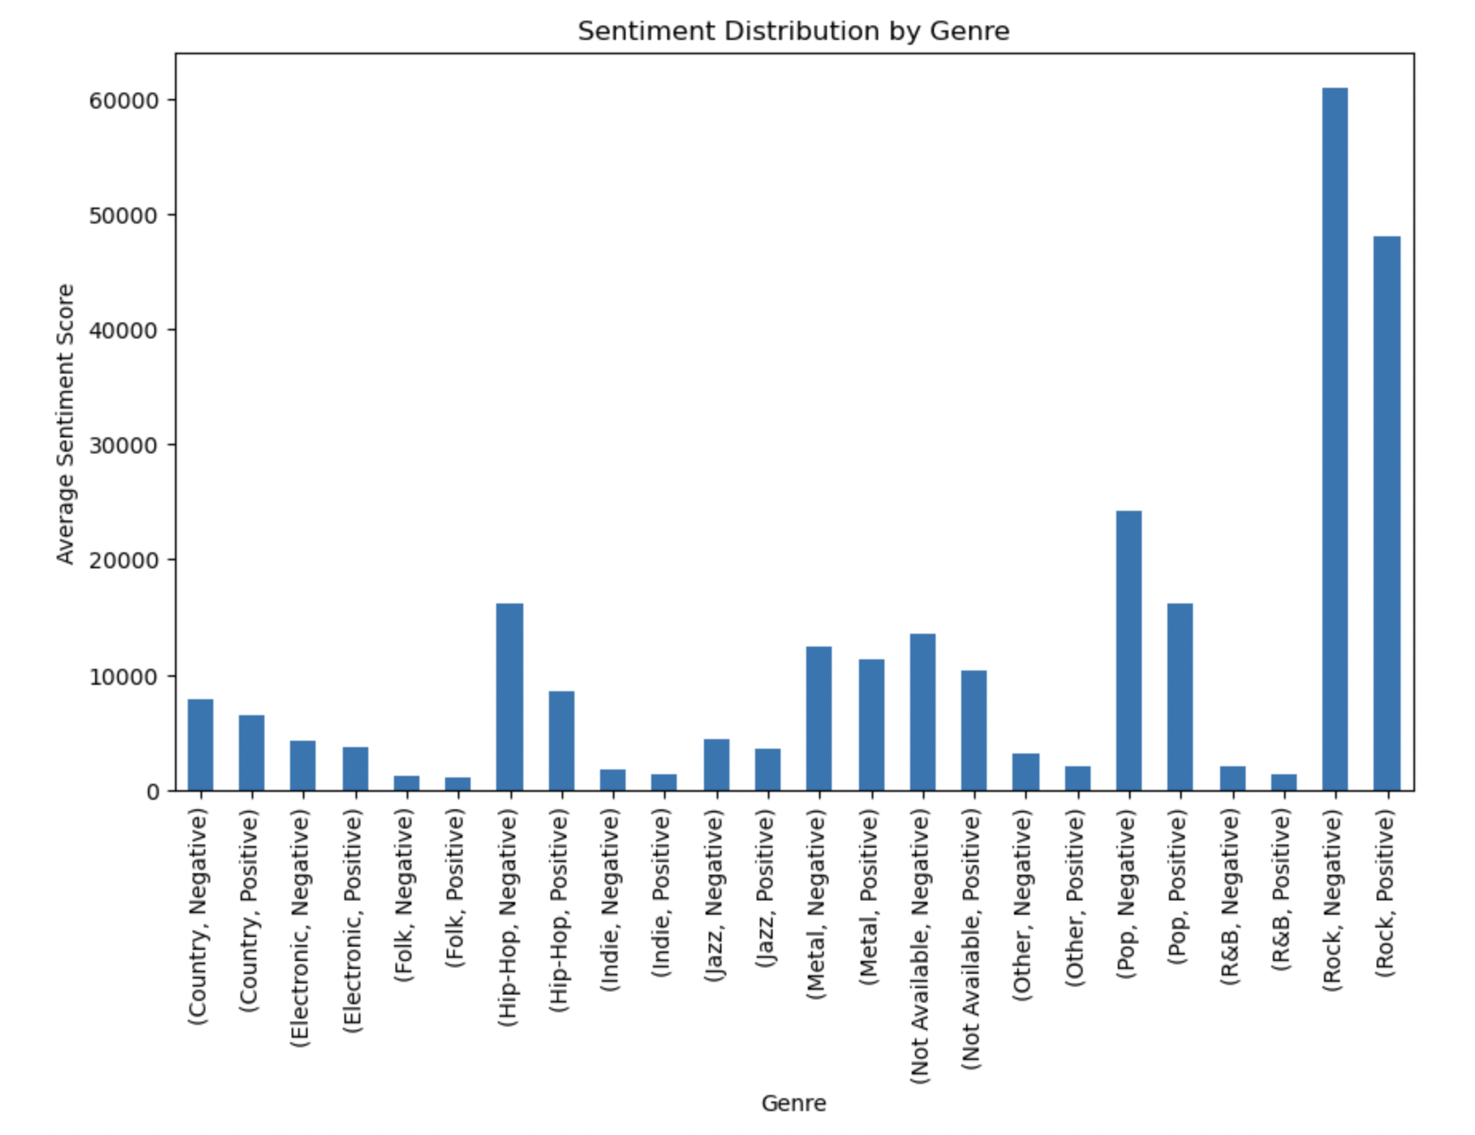
Exploratory Analysis

Slide 5
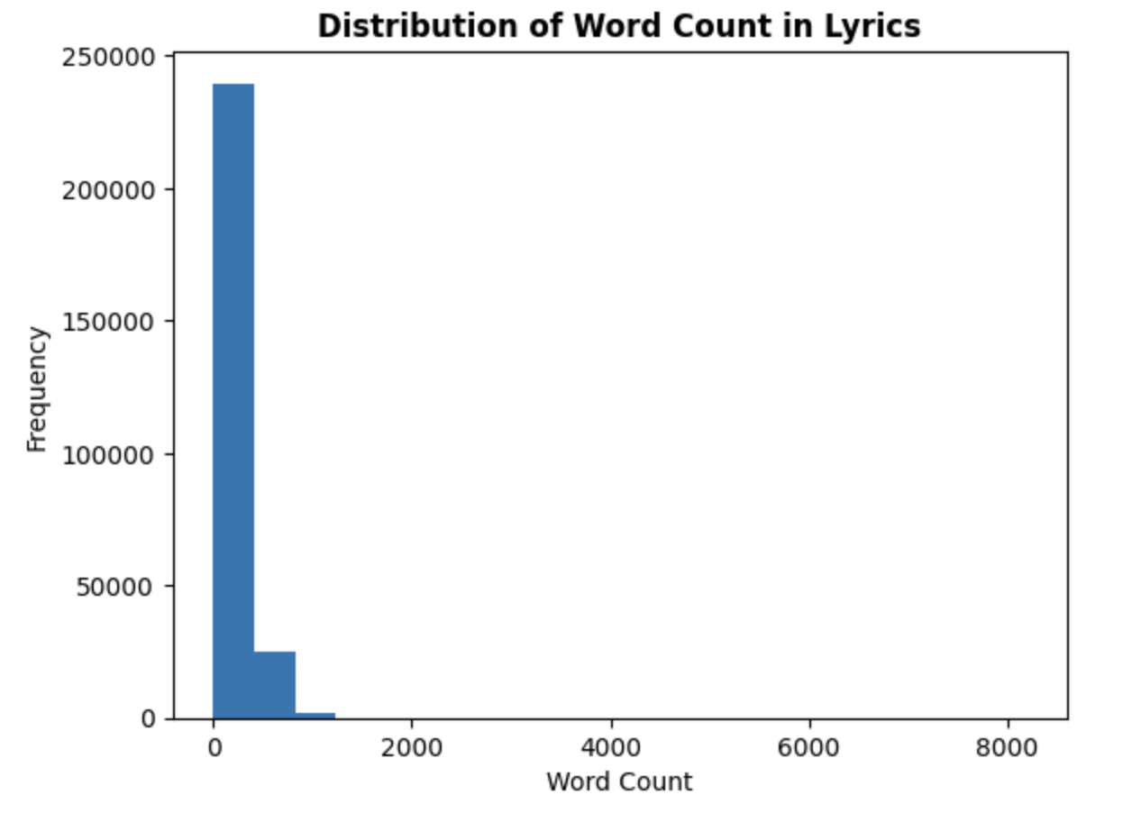
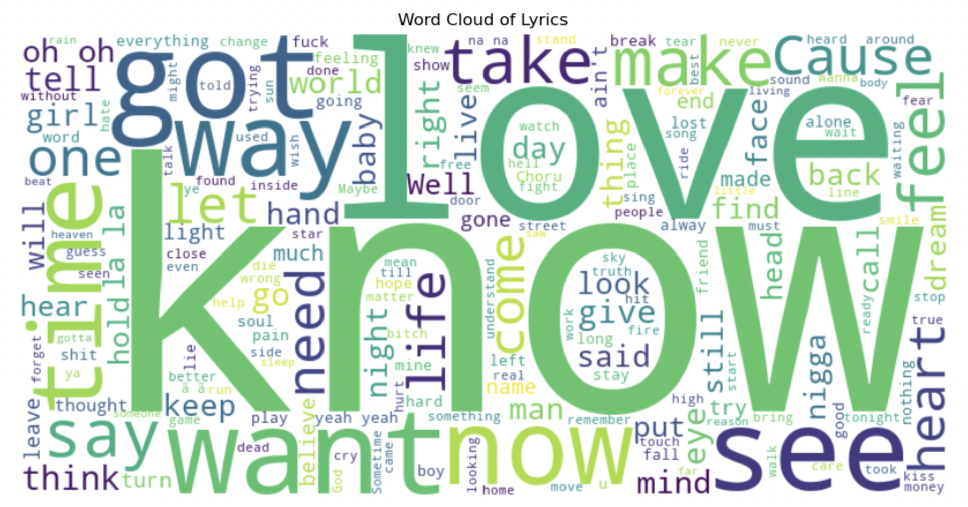
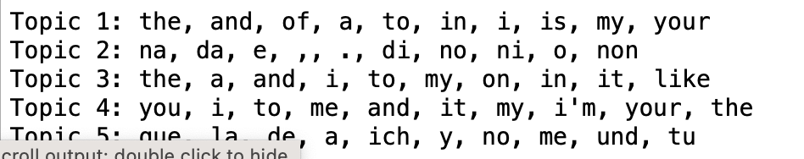
Lyrics Analysis
LDA Analysis
Some common words used are:
Notes:
Divide by each 10 years:
1. word frequency of each 10 years
2. leng of lyrics of each 10 years
Word cloud of each 10 years

Slide 6
Songs Changes over Decades
02
Length & Genre of the Decades
Favorite Words of the Decades
01
03
Sentiment of the Decades

Slide 7
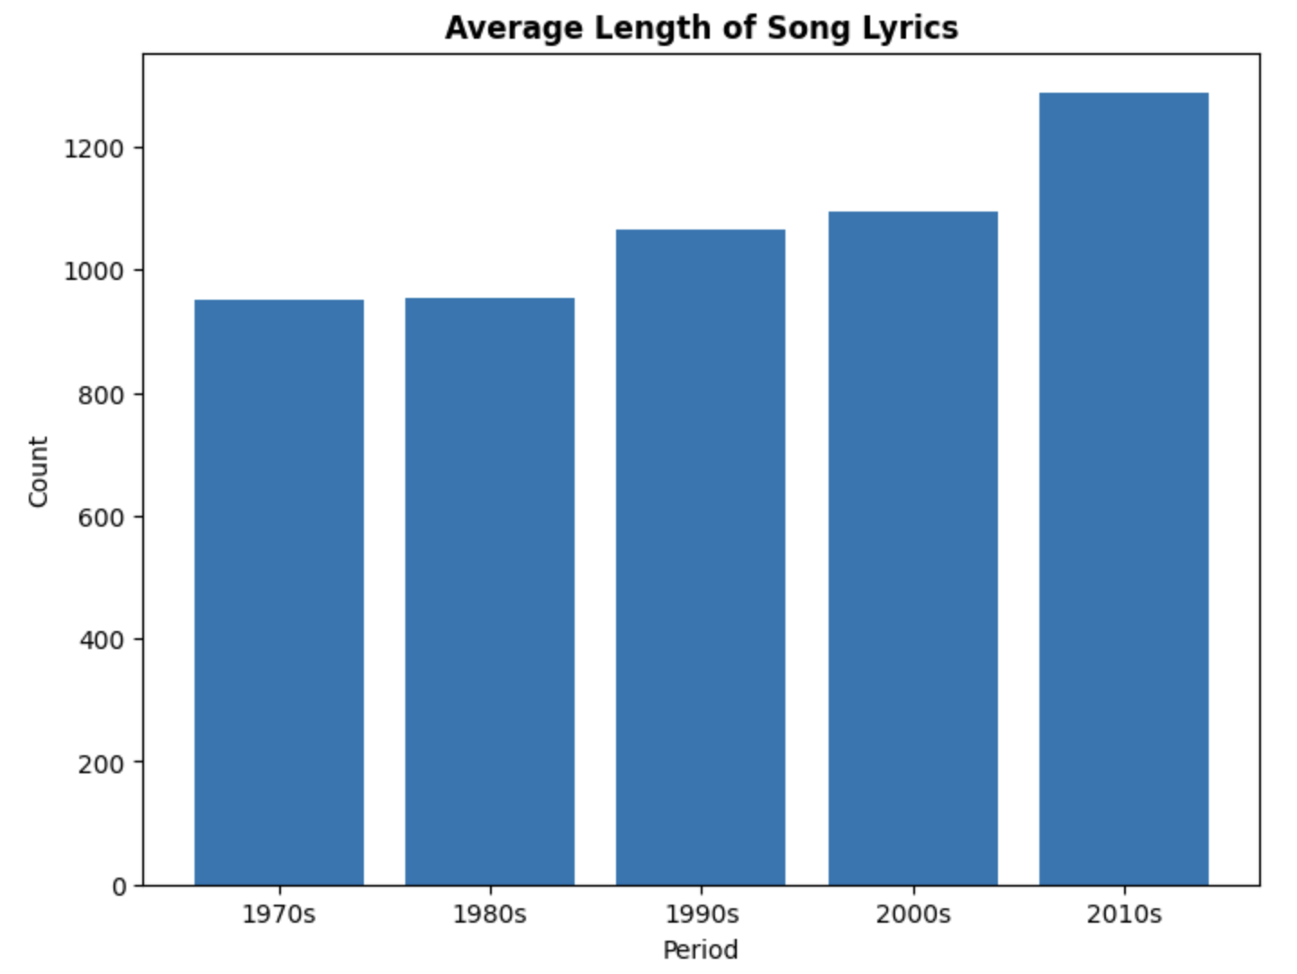
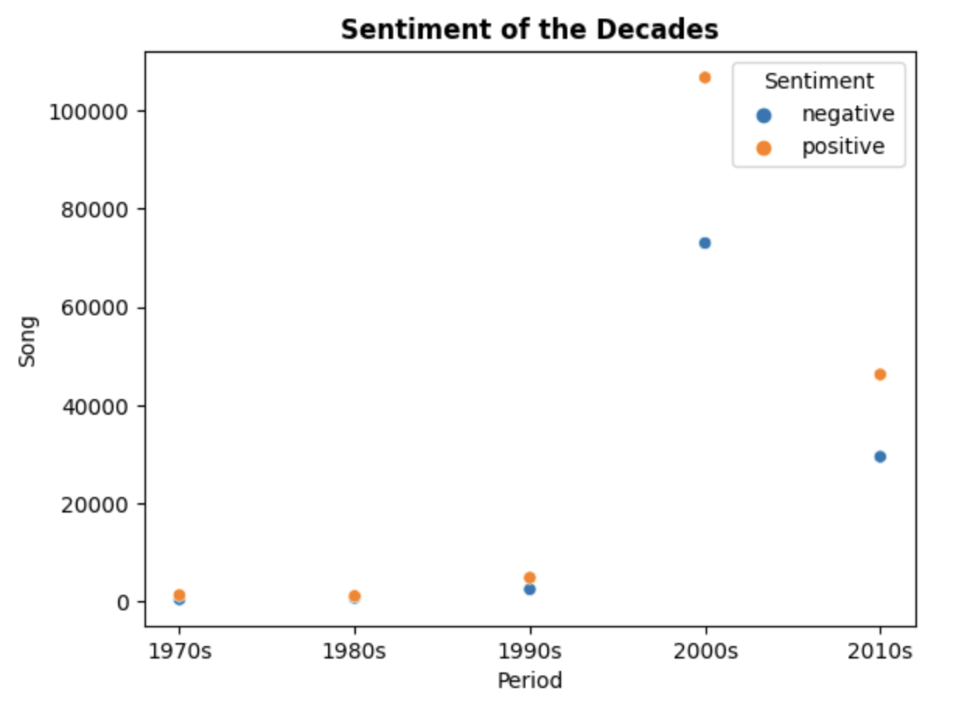
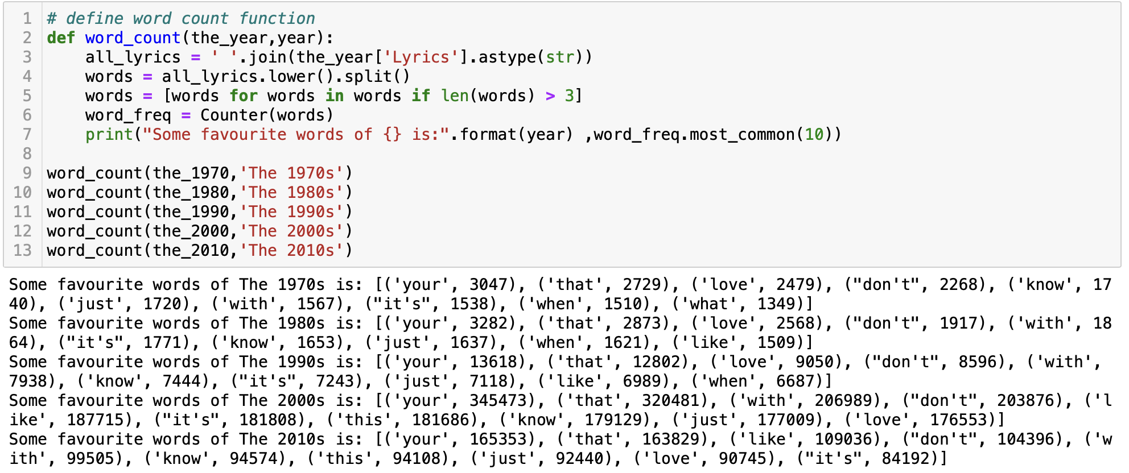
Length and Sentiment of the Decades
The average length of Songs increased over the Decades
Positive sentiment was higher than Negative in all the decades

Slide 8
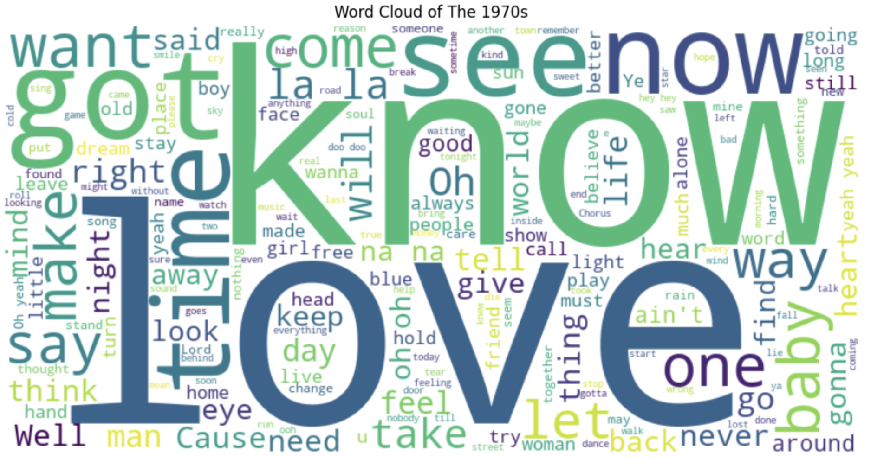
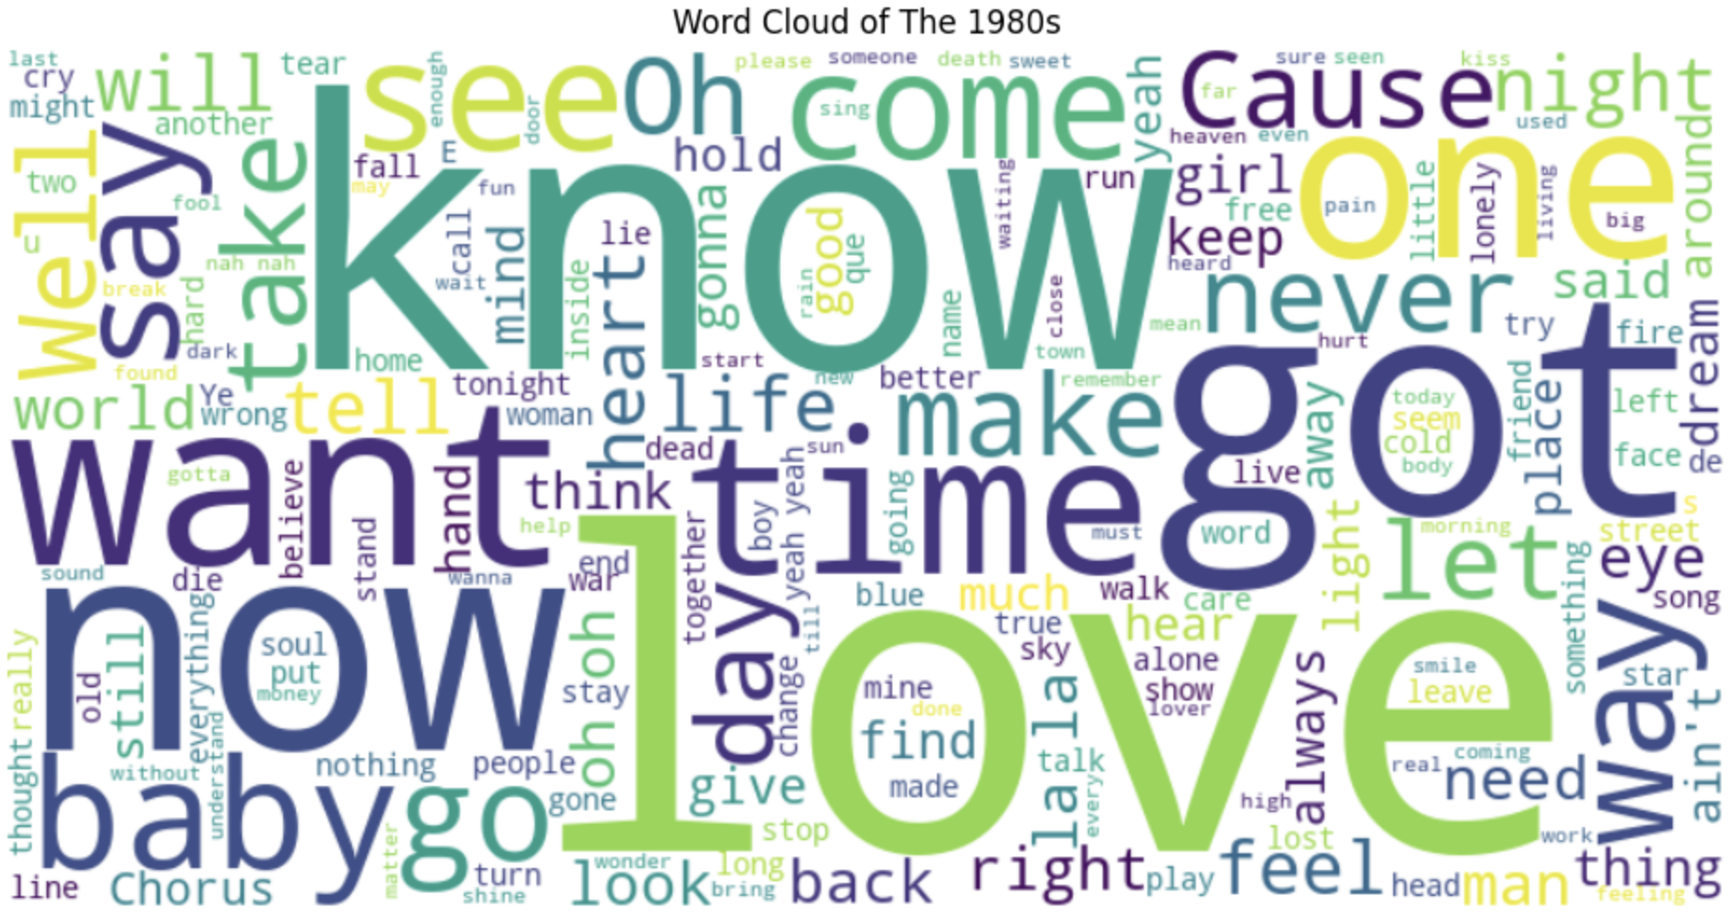
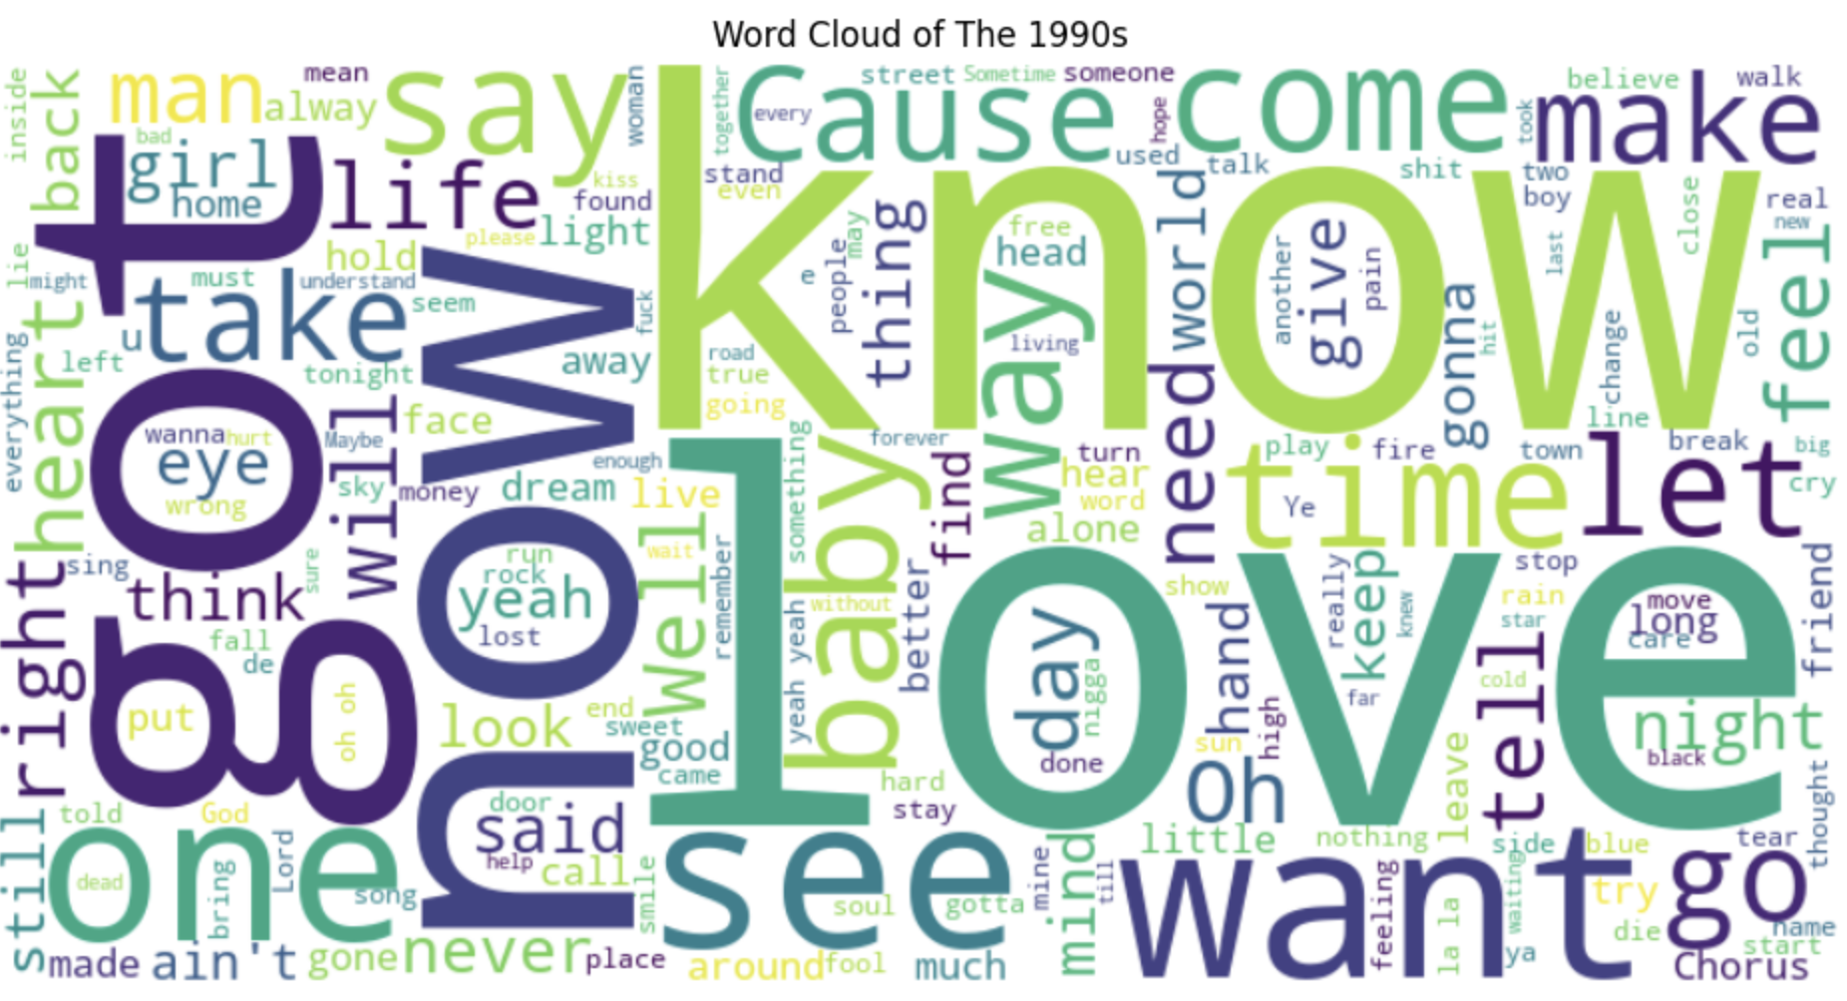
Favorite Words over Decades
1970s
1980s
1990s

Slide 9
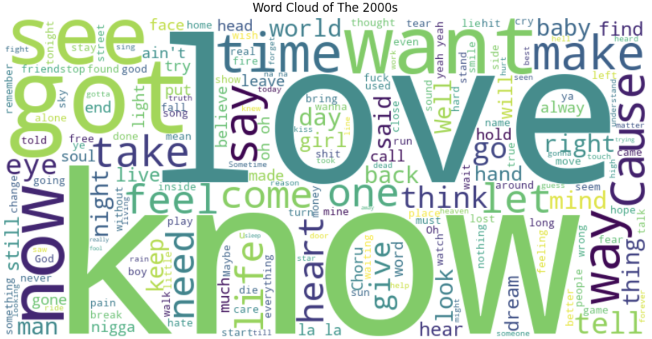
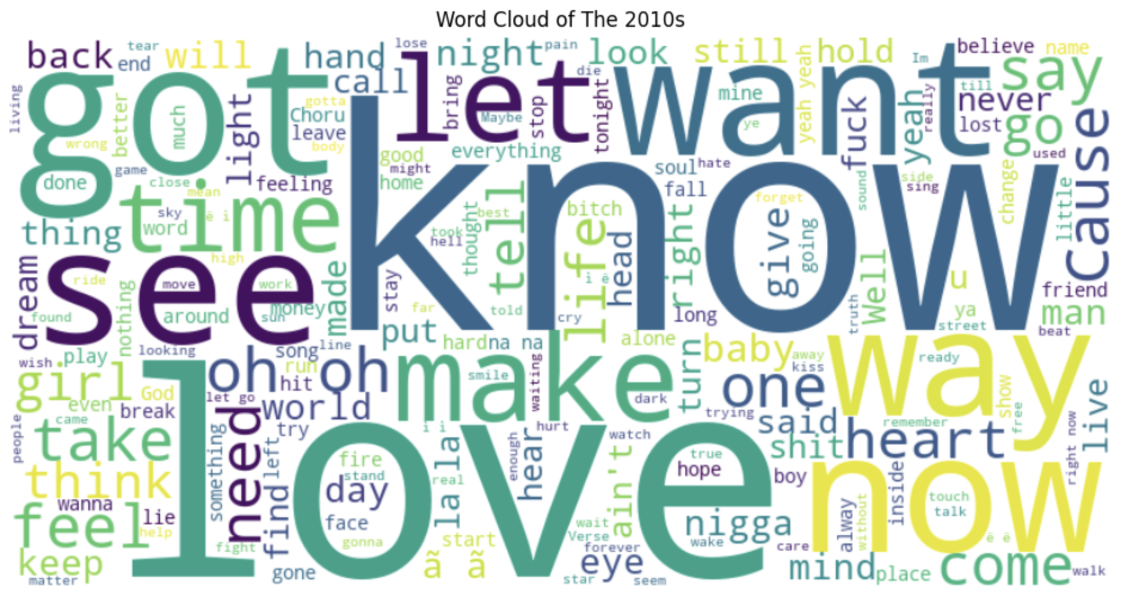
Favorite Words over Decades
2000s
2010s
'Know’ and ‘Love’ took up most of the common words in all decades, with different proportions from time to time
Other common words were mostly Verbs (‘See’, ‘Got’, ‘Want’,…) and ‘Now’

Slide 10
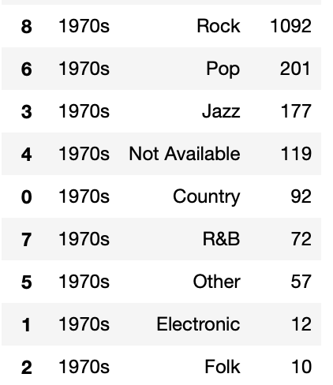
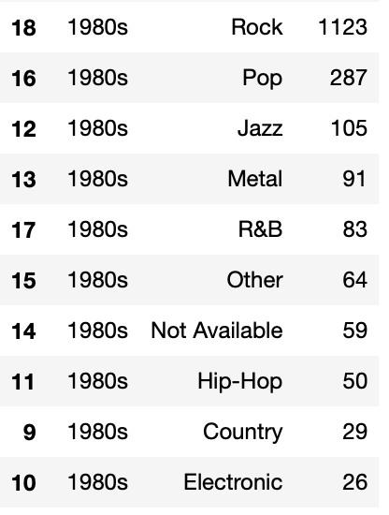
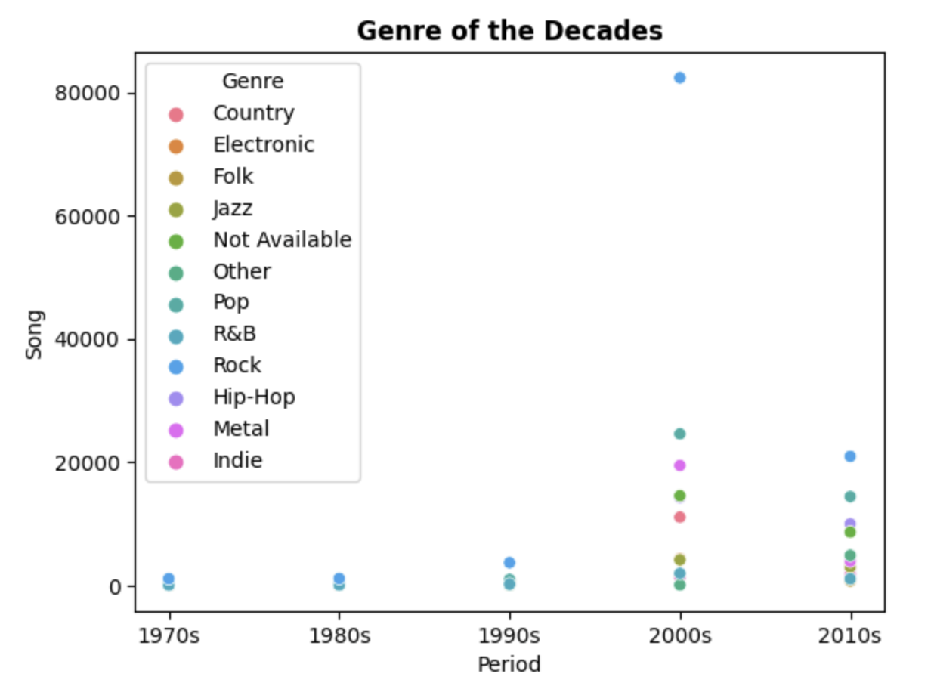
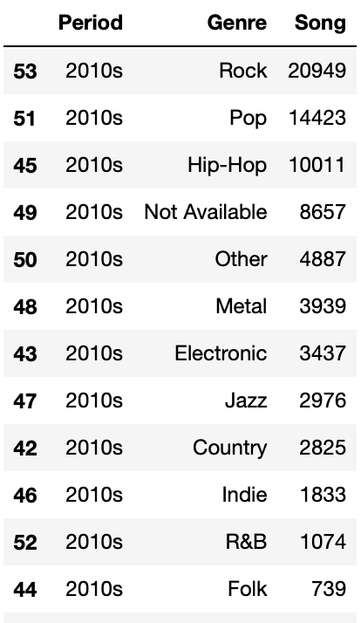
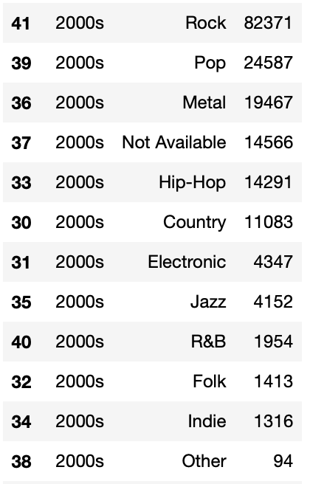
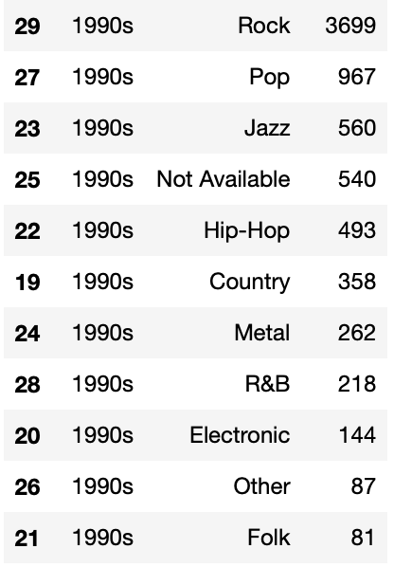
Genre of the Decades
All the decades had Rock as the highest occured genre
The disparity in the 2000s is highest among all decades

Slide 11
Report Conclusion
Favorite Words
Length & Genre
Sentiment
“Love” and “Know” are most seen words in songs over the Decades with different proportion
The songs tend to get longer and had more variety in recent decades
Positive sentiment was higher in all the decades

